Slide 1
F-POD Project Data Management

Slide 2
Basics
Have a Data Manager
Have site names that are specific, easy to use, and are used with 100% consistency. Train all who read SD cards to use these.
Have a plan for sending all the data to the Data Manager.
Have a location to store a fully backed copy of all data.
If relevant - have an agreement on access to and use of the data.

Slide 3
Data tasks
File naming
File checking*
File cropping*
Recording files and metadata
KERNO-F processing
Archiving
Data validation
Data export and analysis
Tasks 2-6 … normally done by Data manager.

Slide 4
Data directories
‘ProjectDirectory’
‘FP1Uploads’ - newly received FP1 files.
‘Docs’ - everything except FP1 and FP3 files. Includes metadata. Can have any sub-directories
‘Useful files’ – the definitive set of cropped and checked data files, FP1, FP3, and associated map files (.f1m, .f3m). No subdirectories.
Backup archive – of at least ‘useful files’ and ‘Docs’

Slide 5
What the Data Manager does:
Examine all new FP1 files, checking for:
Evidence the deployment is normal – dates, angles, temperatures, data volume are as expected.
File name fits policy for project.
Add any notes, water depth, etc. required.
Add site code*
Crop file end(s).
Put the cropped FP1 in ‘Useful files’ and process it through KERNO-F using any special settings that have been chosen (normally there will be none).
Examine the new FP3 file:
Check the time distribution of ‘LowQ’ trains matches higher Q classes.
Check the time distribution of trains of ‘unclassed’ species matches the other classes.
Check the features shown on the Analysis page of the menu are as expected.
Check the File warnings.
Add any new notes arising from this to FP3 file.
Add file information to metadata spreadsheet / database or whatever is in use.

Slide 6
File naming
MbNW1 2017 3 10 FPOD_0004 file0.FP1
Location date of file start POD identifier file number type
this deployment
Keep all files in one directory
Use stable location names. If a site moves more than 200m a new name is needed e.g. MbNW2 etc
(If you want to use the array viewer there are rules on the first 3 characters… but files could be renamed)
Let FPOD.exe construct the name after the location part
then
File lists in Windows can be sorted by place, deployment date, POD number, or by file type, or file date
Batch exports are quick and easy

Slide 7
Cropping files
Cropping = remove the ends of the file where the POD was not fully deployed and noise from the vessel had gone, or not yet appeared..
See the video
How to crop files:
https://www.youtube.com/watch?v=ftEf_nNuqWE
View the uncropped and cropped FP1 file(s) together on screen to confirm the cropping is good.
Move the cropped FP1 files to ‘Useful files’
Important: cropping should be done once only so that duplicate versions of a file are not created.

Slide 8
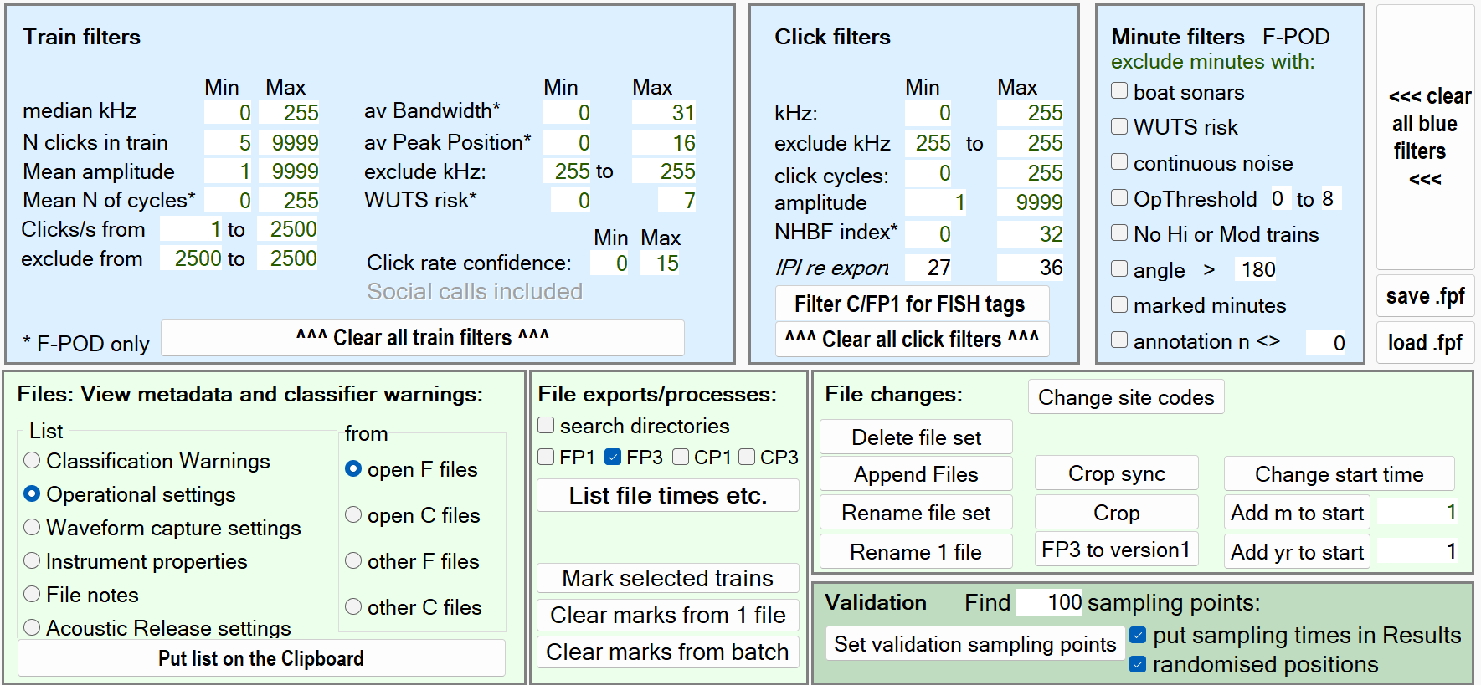
Site codes
These are optional 7 character codes that should identify one specific site
They save space in large data sets, as they can often replace long file names
The site code can be entered when the file is made or later
This button can change the code for a whole selection of files

Slide 9
KERNO-F processing and archiving
You may have done this before cropping a file, but it does need to be done again after the file has been cropped to remove any bias created by earlier or later detections.
A video tutorial is on the website on using the KERNO-F classifier.
https://www.youtube.com/watch?v=Ffd8YR4ILsc&t=292s

Slide 10
Data validation
At some point the error risk reports on each file must be listed and checked. See the video on this.
Carry out detailed validation where needed – see this video on the Chelonia YouTube site:
https://www.youtube.com/watch?v=d0M36c5oFLU
And this video explains how to quickly step through a statically valid set of points in your data:
https://www.youtube.com/watch?v=RmZp-8F7mAo

Slide 11
thank you for your attention

