Slide 1
Comparing echo-location monitoring instruments
Nick Tregenza, Chelonia Ltd / Exeter University
Feedback, and comments, especially adverse, are welcome and greatly appreciated: nick.tregenza@chelonia.co.uk

Slide 2
Major issues in static acoustic monitoring:
False positive detections, by species group
Cost of frequent servicing
Cost of data analysis
Unstandardised performance
Sensitivity

Slide 3
False positive risk by 'species' group:
Lower error risk: Porpoises (NBHF), beaked whales, boat sonars.
Greater error risk: Dolphins (BBTs)
NBHF = narrow band high frequency clicks; long tonal clicks. BBT = broad band transients; shorter clicks of greater bandwidth.

Slide 4
False positives:
Reliable comparisons must include 'adverse conditions' such as:
sand movement. All sandy sea-beds sometimes move.
boat sonars at the 'wrong' frequencies
dolphins in porpoise areas
propellers, shrimps, etc.
If these are not included the applicability of the comparison is very restricted (e.g. to quiet places).
False positive rates are most useful if they are expressed in terms of the prevalence of the sounds that give rise to them. Failing that, as a rate per day.
False positive rates expressed as a percentage of all positives are meaningful only if the ‘all positive’ rate is given, so that FPs/time can be seen.

Slide 5
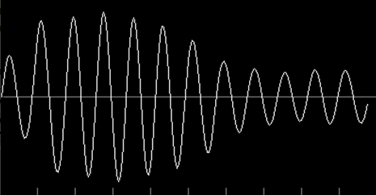
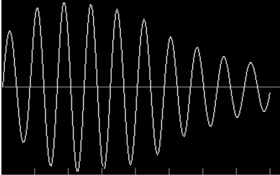
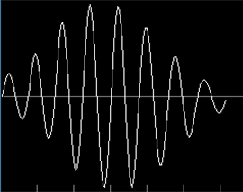
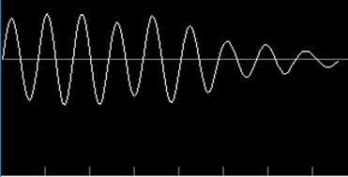
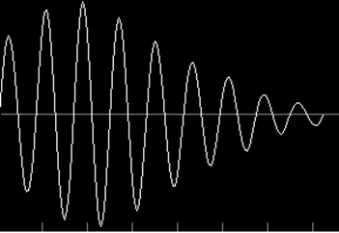
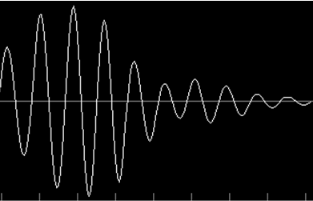
Narrow Band High Frequency clicks from a C-POD-F. All these are well inside the PAMGuard basic criteria:
< sand
sand >
< HP
HP >
… also
shrimps
bubbles
propellers
sonars …
< sand
dolphin >
Click by click identification is unreliable for porpoises,
and works much less well for dolphins.

Slide 6
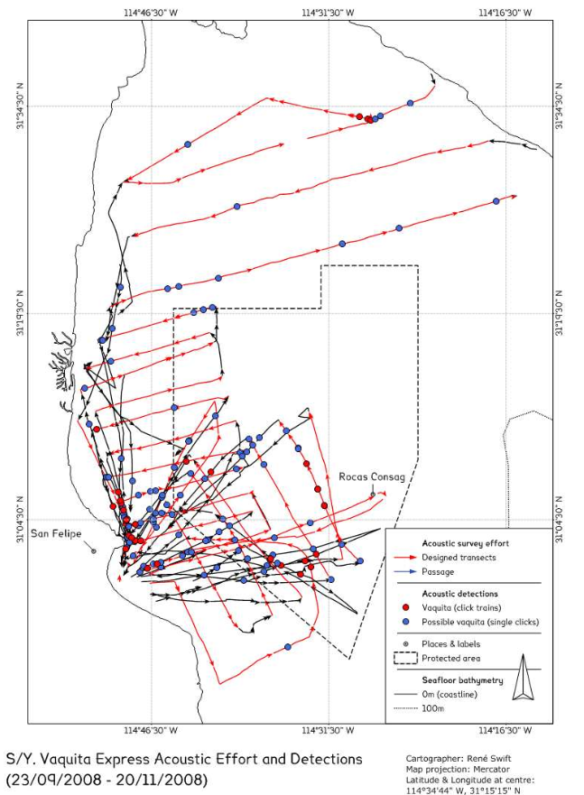
Sea tests: Vaquita Monitoring Trials, 2008.
Towed hydrophone, PAMGuard basic NBHF detector:
probably false possibly true
These data come from use of the standard PAMGUARD porpoise click detector on data from a hydrophone towed by a small sailing boat in a trial of methods carried out in the Upper Gulf of California to select a method of monitoring that could overcome the massive cost and other problems of repeated visual line transect surveys.
‘Vaquita click trains’ here refers to groups of clicks without specific criteria on inter-click-intervals.
Detections to the left of the red line are extremely unlikely to be true as Vaquita have not been seen there for many years, while the main concentration of animals is within the core refuge marked by the dotted line.
The false positives here dominate the results making the method unusable, or if visual filtering is used, dependent on subjective evaluations that have never been adequately compared and tested, and did not work in this trial.
C-POD data showed a strong match to the distribution of sightings, because of their much lower false positive rate, and have given good data in this location ever since.
NOAA-TM-NMFS-SWFSC-459 Technical Memorandum
Armando Jaramillo-Legoretta, Gustavo Cardenas, Edwyna Nieto, Paloma Ladron de Guevara, Barbara Taylor, Jay Barlow, Tim Gerrodette, Annette Henry, Nick Tregenza, Rene Swift, Tomonari Akamatsu

Slide 7
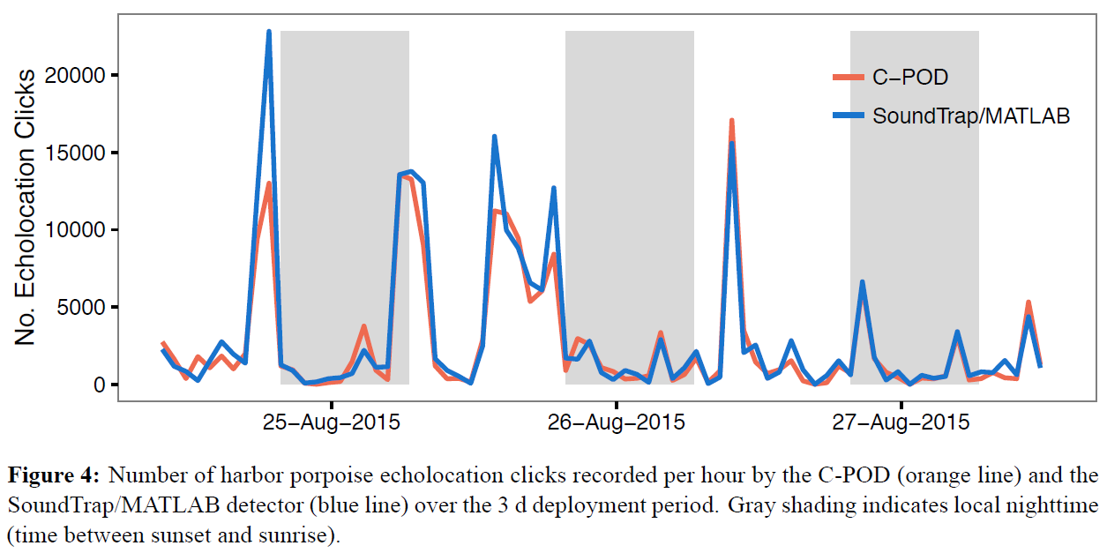
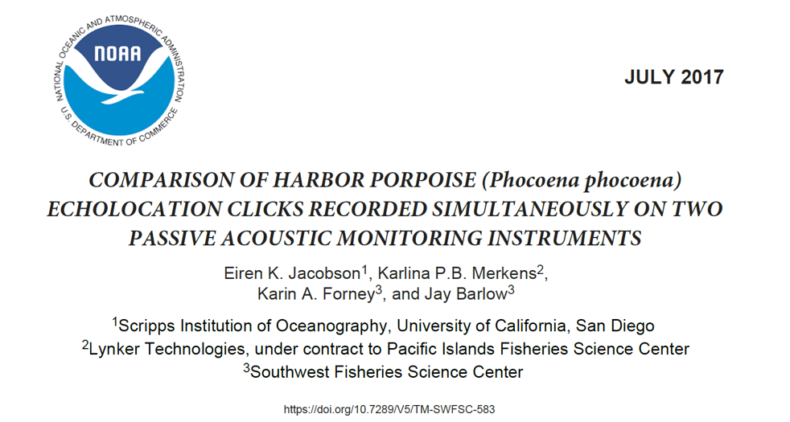
Sea tests: Sound Trap/ Matlab : C-POD 2017
These data, by contrast, show a very good match between methods. This is substantially due to a lower level of sources of porpoise-like clicks in quieter locations studied here, than in the noisy environment of the Vaquita trial. The Matlab detector is similar to the PAMGuard detector.

Slide 8
False positives in comparisons:
Reliable comparisons are made at similar false positive levels in adverse circumstances.
If this is not done a seriously over-sensitive detector will appear preferable, but may perform much worse when exposed to adverse acoustic conditions.

Slide 9
C
So reliable comparisons are at
similar false positive levels
in adverse conditions:
100%
Which is better?
B
A
true positives
false positives
B - twice as sensitive as A, but has 5 times as many false positives.
C - is even more 'sensitive', but is counting multipath replicates, and has 10 times as many false positives.
What sensitivity do you need? Most SAM projects have plenty of detections and reducing false positives is much more valuable than getting more sensitivity.
multipath replicates = echoes and longer refracted pathways (like the twinkling of stars)

Slide 10
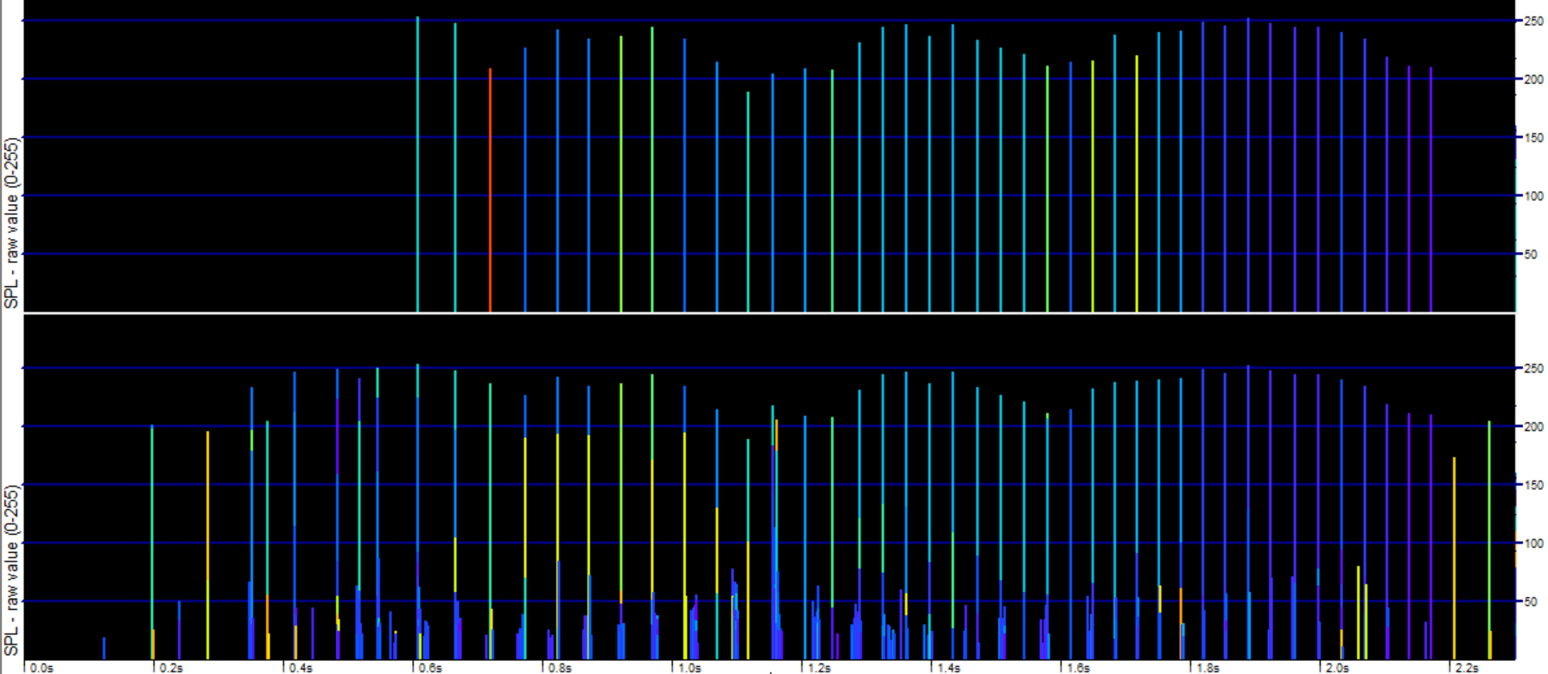
Over-counting:
Click counts need to exclude multipath replicates:
40 'true' dolphin clicks found by the KERNO classifier
among 608 dolphin clicks:

Slide 11
Algorithm or brain?
If data from instrument A is analysed by eye, a comparison needs to be made with the data from B also analysed by eye. This is because:
Analysis by eye may give better performance than an algorithm (or sometimes worse).
The level of agreement is likely to be higher when the same method is used for both.
The time cost of visual validation of each data from each instrument can be stated.
Different analysis methods may offer different strategies for limiting the workload with big differences in time costs e.g. automated analysis may be good enough to direct the analyst to a very small subset of the total recorded time.
Different analysis methods may have very different exposure to analyst (subjective) differences.
Note: both methods will generally be black boxes:
Brains are always black boxes. They can be tested, but results can drift unpredictably.
A published algorithm is still generally (1) a black box by virtue of its complexity, (2) its sensitivity to unccontrolled input data features and (3) incomplete knowledge of input data characteristics, so it's performance cannot be confidently predicted from the published code.
‘Weak unknown train sources’, identified in C-POD data are a striking example of our incomplete knowledge of input data characteristics.

Slide 12
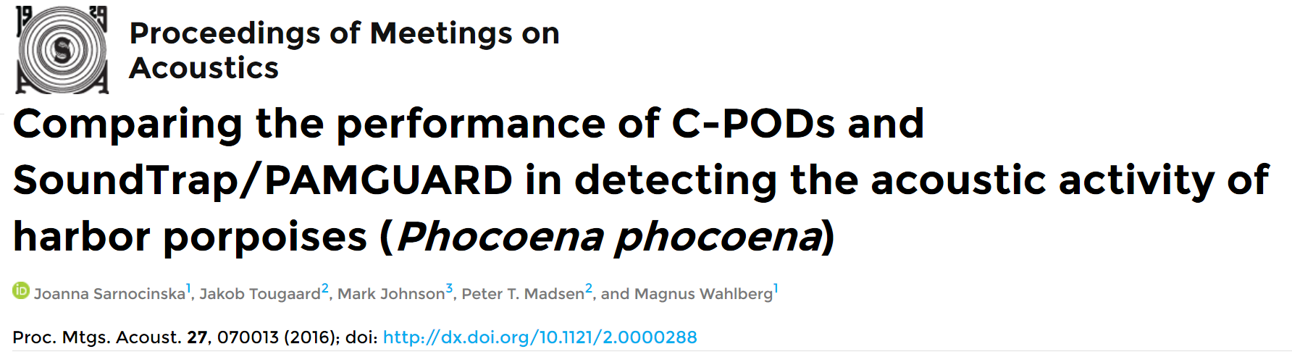
Comparing instruments: a test case:
Examination of this data shows that big differences can exist in the results of analysis by different analysts.
Some of the input data from the SoundTrap is presented here.
First the good results, then the bad results:

Slide 13
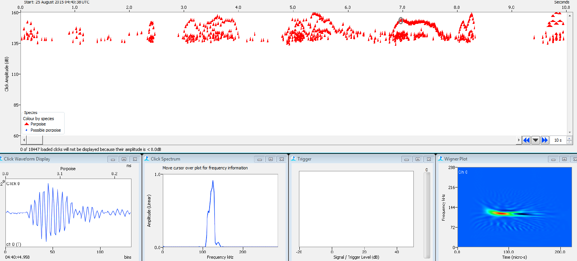
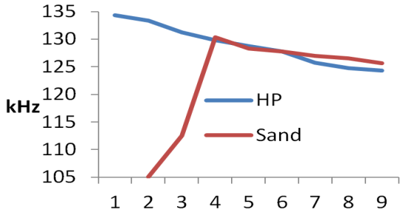
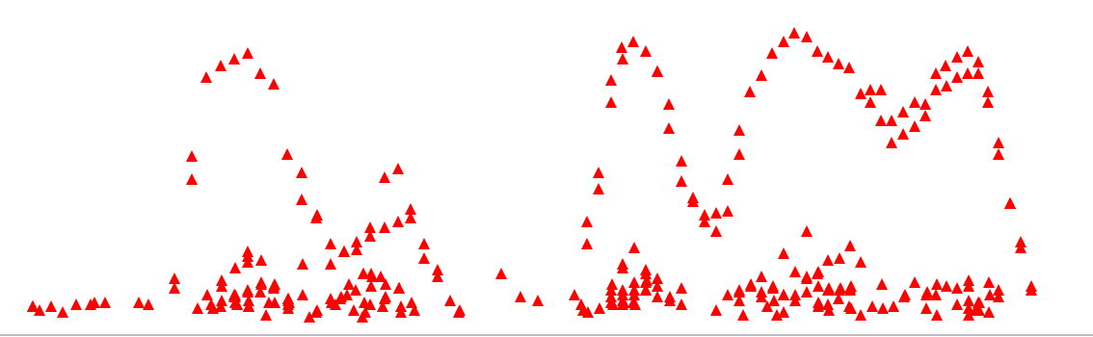
Comparing the performance of C-PODs and SoundTrap/PAMGUARD. POMA paper
SoundTrap / PAMGuard data - the good data:
The amplitude plot here shows typical click train amplitude envelopes going up to 160dB
with weaker multipath clicks seen below, giving a very typical structure..
The Wigner plot shows a slight frequency downsweep within the click and matches the typical C-POD-F finding:
Typical waveform with quiet background (seen before click)
All aspects of these PAMGuard detections closely match C-POD-F detections of porpoises as shown in this actual C-POD data from elsewhere:
The C-POD-F captures successive wavelengths within some clicks. This graph shows the average of number of clicks from each source

Slide 14
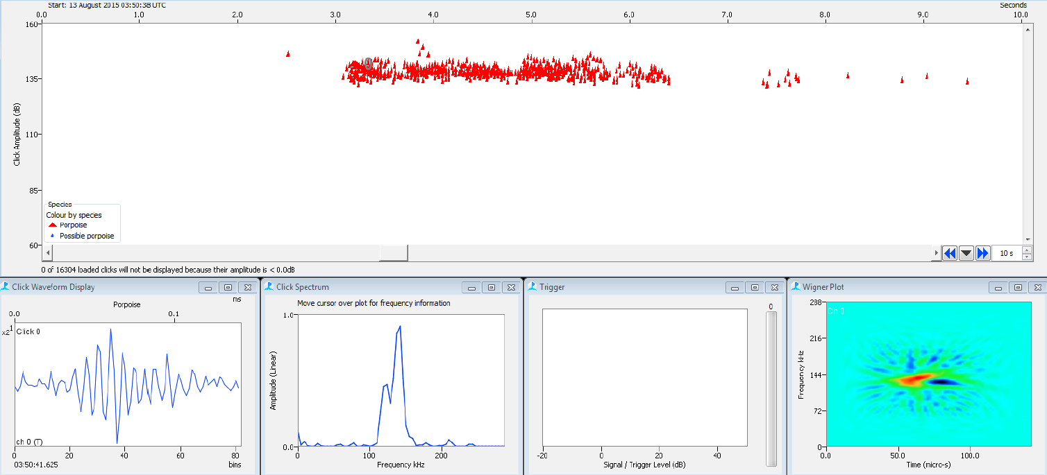
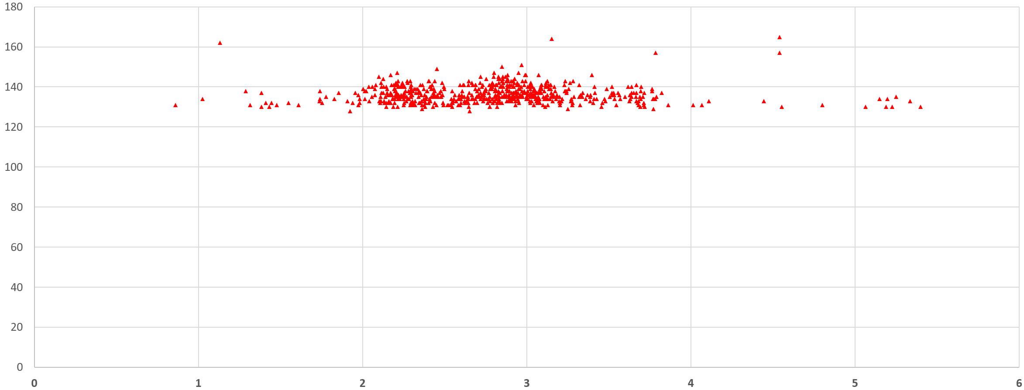
This data from the POMA paper is very different : the bad data:
This is a too-long weak train. Such long weak trains are very rarely captured from swimming animals because of the narrowness of a weak beam. It shows no very distinct amplitude envelopes, no clearly coherent sequences of inter-click-intervals, no distinctly weaker multipath clicks, and the click details are unlike porpoises:
The Wigner plot shows an initial rise (red) and then a slight fall (blue) as seen in C-POD-F data from sand noise. (see previous slide)
poor waveform: ragged amplitude profile. Background noise at ends looks rather similar.
The peak amplitude profile matches this actual C-POD data from sand noise. This is an example from elsewhere:
Conclusion: All aspects of these PAMGuard detections match C-POD-F detections of known sediment transport noise, but they have been classified in this paper as porpoise clicks.

Slide 15
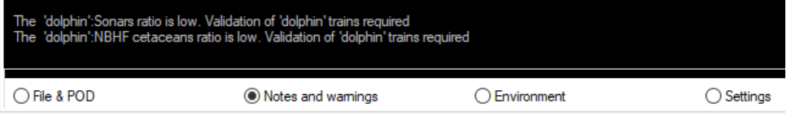
Comparing the performance of C-PODs and SoundTrap/PAMGUARD. POMA paper:
The second set of clicks (previous slide) from the SoundTrap is typical of sand noise - the 'blue grass' that is more easily recognised in CPOD.exe click amplitude displays where the lack of train structure is apparent:
Issues:
  With such major errors it is currently difficult to know which results from wav file recorders / PAMGuard to trust.
  No guidelines exist on how to ‘calibrate’ analysts.
  Critical study of PAMGuard + human filtering is essential: across analysts, including adverse conditions, and giving explicit identification of failure modes.
  Three international workshops* have looked at these issues for C-POD data and characterised failure modes for NBHF species: dolphins, boat sonars, sediment transport noise, other noise, chink sounds, 'mini-bursts' and playbacks, and all these have been used in the KERNO and encounter classifiers. These automated classifiers give warnings in CPOD.exe where too many classifications are of marginal quality, or sources of false positives are relatively numerous: e.g.
  Refereeing of papers will often fail on pattern recognition results. The scientific community needs to make progress on how to handle such data in publications.
* Poland, Mexico, Sweden

Slide 16
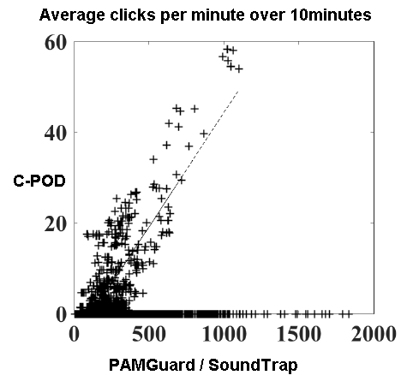
Comparing the performance of C-PODs and SoundTrap/PAMGUARD. POMA Fig 2 (b):
This data set shows two distinct distributions:
1. Matching results - blue ellipse ( porpoises)
2. Non-matching results - red rectangle
Where is the evidence that these clicks (2) came from porpoises?
No evidence is presented other than their similarity to porpoise clicks + an unsupported assumption than nothing else will be like a porpoise. However:
Not one of multiple studies with actual sighting effort ever saw the highest levels of porpoise activity entirely missed by C-PODs, but this paper interprets and uses the data many times in that way.
A more economical interpretation is that these very high counts from PG/SoundTrap are false positives.

Slide 17
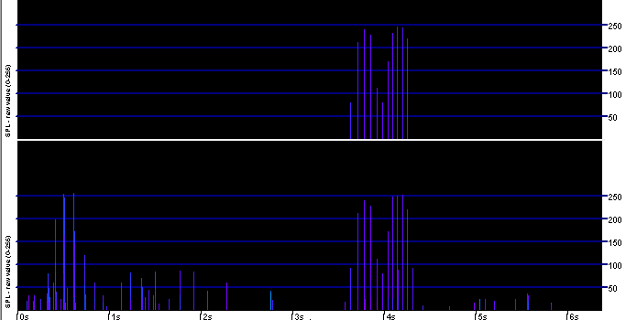
Comparing the performance of C-PODs and SoundTrap/PAMGUARD. POMA Fig 2 (b):
Where do the differences in click counts come from in the matching distribution?
1. ‘Uncertain’ trains rejected by C-POD?
2. Multipath replicates (reflections and refractions)?
Overall: 340 clicks in raw data, 11 in train
One train missed, one detected, by C-POD.
So (1) does explain part of the difference.
(2) explains a larger part. The lower number from the C-POD is more useful, as it is not determined less by range and propagation conditions, and more by the actual number of clicks producing the received sound.
Click train found by KERNO classifier
Raw data input to KERNO classifier

Slide 18
Data validation
Published papers typically refer to data being filtered or validated by experts but do not state what those experts consider or how far they agree. This recent publication on F-POD date gives an explicit description of the process that can be followed for POD data and the results from the BlackCeTrends project:
Validation of the F-POD—A fully automated cetacean monitoring system
Julia Ivanchikova, Nicholas Tregenza
PLOS ONE https://doi.org/10.1371/journal.pone.0293402

Slide 19
Abstract
A total of 16,805 Detection Positive Minutes (DPM) were individually inspected
the fraction of NBHF DPM containing misclassified NBHF trains was less than 0.1%
the fraction of Dolphin DPM containing misclassified dolphin trains was 0.97%.
The main sources of errors were:
  0.17% of boat sonar DPMs misclassified as harbour porpoises
  0.14% of harbour porpoise DPMs misclassified as dolphins
The potential to estimate the rate at which these sources generate errors makes possible a new predictive approach to overall error estimation.

Slide 20

Background … noise
Acoustic studies have mostly focussed on sound made by animals and sound made by humans.
Most animal studies select quiet conditions to give clean data, but this means researchers do not see many natural noise sources and may wrongly believe that only porpoises produce porpoise-like clicks.
Sediment transport noise has been well described by Thorne and other researchers but is still missing from all textbooks on marine acoustics…
… except there is now a summary in the chapter on PODs in:

Slide 21
Comparing instruments:
Cost of frequent servicing :
time for an instrument be downloaded, recharged, and replaced at sea. If one of these is very slow, do you need a second set of instruments?
number of sea trips per year of data?
mooring cost - can this be reduced by acoustic releases?
cost of lost instruments and data?

Slide 22
Comparing instruments:
Cost of data analysis: (post download)
file handling time - moving, copying, archiving, distributing and managing file sets.
automated analysis time (train detection, FFTs, Long term spectral averages)
validation time (quality control, no editing, if quality is good enough)
editing (analysis) time - this can be huge.
time cost of analyst calibration - testing if analysts give the same results.

Slide 23
Comparing instruments
Standardisation:
Reliable comparisons include:
Availability of a standard metric - Detection Positive Minutes, Sum of train durations, 'True' click count, etc. Comparing total click counts including all multipath and false positives with a true click count is not reliable. Multipath counts may rise in shallower water, creating a bias. 'True' counts aim to count the number produced by the animal.
Calibration of analysts. Do different human analysts get the same result? Rarely tested, but the results when tested may a shock.
Standard guidelines. For C-PODs there is a visual validation guidance document online. For PAMGuard no guidelines are currently available.
Calibration of recording: hydrophone and system noise.

Slide 24
Comparing instruments: Summary
Good assessment of performance includes:
false positives in adverse conditions
the time cost of analysis
the consistency/standardisation of analysis
overall costs
… and does not express false positives as a % of true positives.
(because false positives still exist when true positives are zero)

Slide 25
Acknowledgments
Thanks to Joanna Sarnocinska for access to data from her Master's Thesis used in the POMA paper discussed here.
Feedback, and comments, especially adverse, are welcome and greatly appreciated: nick.tregenza@chelonia.co.uk

