Slide 1
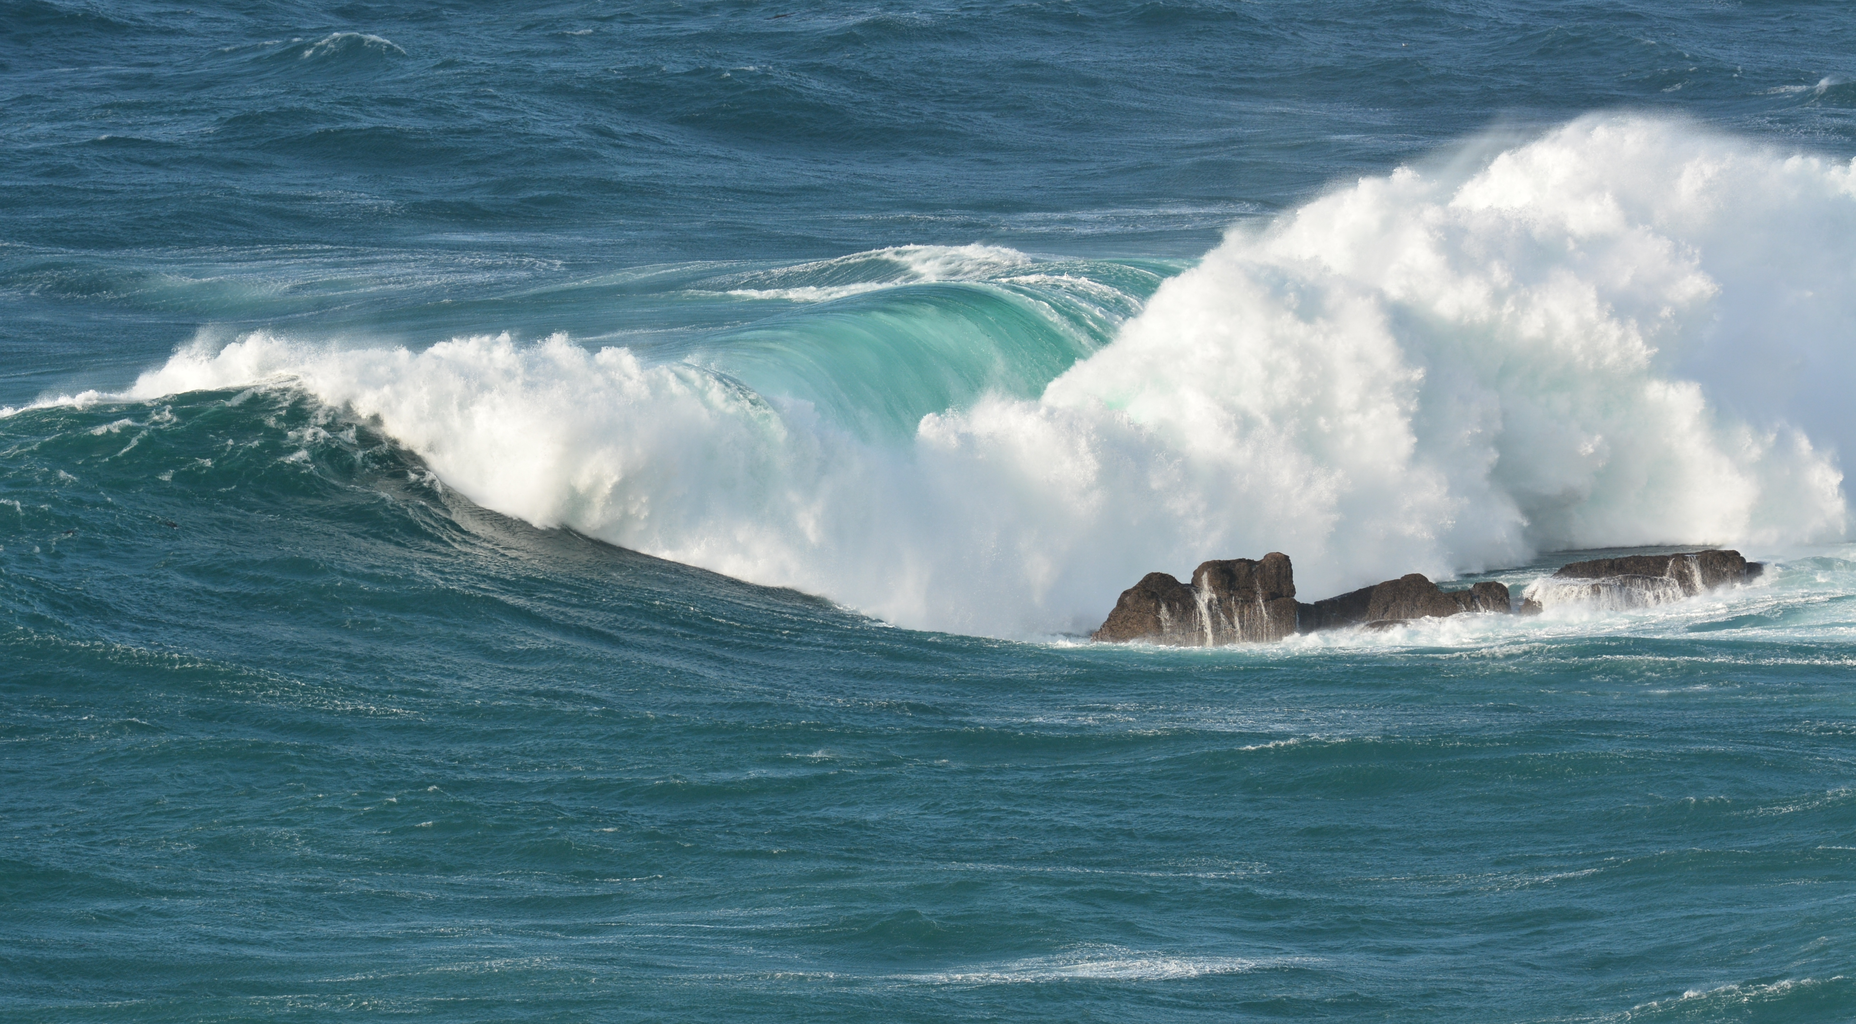
F-POD data
Species, sonars, pingers, sand ...
Can we analyse these independently?
nick.tregenza@chelonia.co.uk

Slide 2
Can the classification of clicks into species groups be ‘independent’ = not affected by the presence of two (or more) species
The KERNO-F classifier puts click trains into three classes that represent porpoises, dolphins and boat sonars, and a fourth ‘unclassified’ class.
The problem: False Positives are serious errors – over time detection rates for a declining species head, not towards zero (extinction), but towards the false positive rate which would look like a low population that was ‘hanging on’.
So False Positives need to be kept very low, which raises major issues for classifiers.
Here is a mostly non-technical discussion of the issues for click monitoring methods:
Topics:
False positives
Independent classifiers: ‘ideal’ and ‘good static compromise’
How a good static compromise fails
Adaptive / dependent classifiers – the concept
How do the KERNO-F classifiers work?
When does the interaction matter?
Solutions and future solutions
References

Slide 3
1. False positives:
For porpoise clicks other sources sometimes make many very similar clicks:
fine sand in suspension. All sandy sea-beds sometimes move...
boat sonars at frequencies found in cetacean clicks
dolphins
Less often from fishery pingers, shrimps and various sources known and often unknown.
Dolphin clicks are shorter and more varied than the narrow-band high-frequency (NBHF) clicks of porpoises. Clicks that could be dolphin clicks occur at high rates in many soundscapes, even when no dolphins are present.

Slide 4
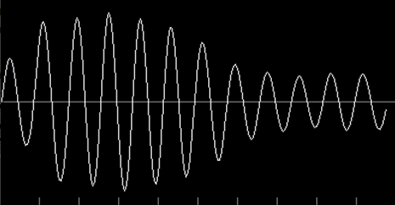
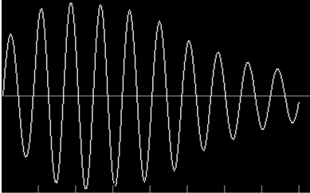
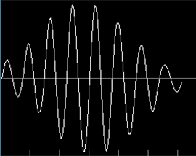
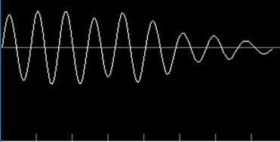
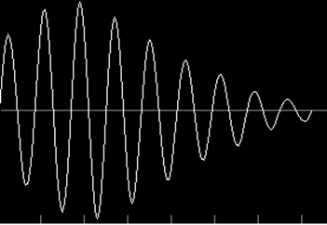
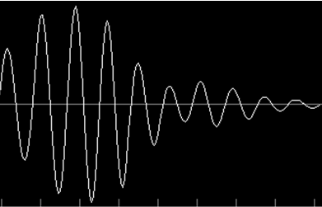
Narrow Band High Frequency clicks logged by an F-POD. All these closely match porpoise clicks in spectrum and waveform.
< sand
sand >
< HP
HP >
< sand
dolphin >

Slide 5
2. Ideal classifier:
If the target click - say a porpoise click - generally has features that are almost never found from any other source then an ideal classifier is possible - it simply counts the incidence of the unique feature, or set of features.
Very loud clicks + the same frequency spectrum + the same waveform profile as typical porpoise clicks do seem to be produced only by porpoises, but counting them is not generally useful because the animal must be close to the hydrophone and pointing at it for them to be received as loud clicks. Clicks from a porpoise at, say 50m will not be loud enough to be accepted by this classifier.
Consequently, the sensitivity of such an ideal classifier is very low – much too low for monitoring purposes - and there are no reported studies that have even tried to use this approach.
Instead, some kind of compromise is needed….

Slide 6
2. good ‘static’ compromise classifier
A classifier can give better sensitivity if it accepts clicks that are too weak or otherwise not ‘ideal’ but do pass some set of criteria e.g. they
have other features commonly found in the target clicks,
do not have some ‘negative’ features that commonly come from the known sources of false positives.
The thresholds of those criteria represent an implicit evaluation of the risk of encountering the sources of false positives. ‘ROC’ curves may be presented – these show the effect of changing the threshold in one acoustic background, but do not show anything about the distribution of backgrounds and are generally unhelpful without that distributional data which is rarely available.
A classifier that is ‘static’ i.e. it always applies the same criteria, may be correctly called ‘independent’, but it will have risks and problems:
  a rise in the prevalence of the sources of false positives will increase the false positive rate.
  if tougher criteria are used the sensitivity will fall and will be low even when the sources of false positives are absent.
  the criteria chosen will have performed well in the development process which may have lacked some of the problem sources/background e.g. sediment transport noise.
The alternative is an adaptive classifier … more later …

Slide 7
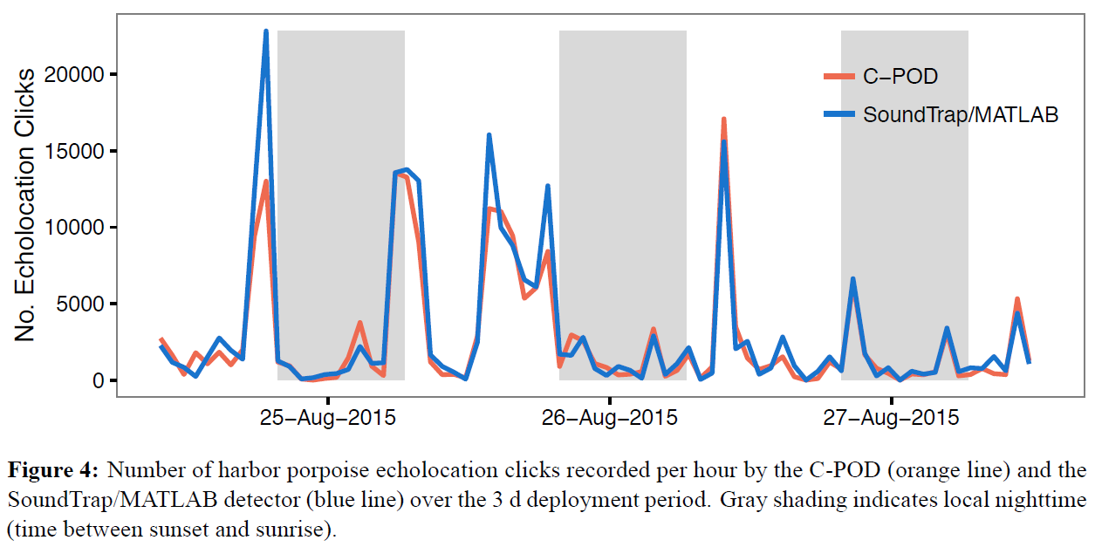
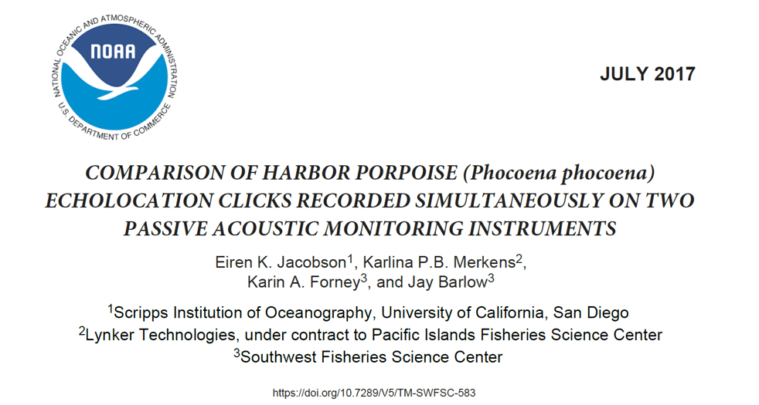
Sea tests: Sound Trap/ Matlab : C-POD 2017
These data show a very good match between these two methods. This is substantially due to a lower level of sources of porpoise-like clicks in the quieter locations studied here, than is seen in other places e.g. the environment of the Vaquita. This Matlab detector is similar to the PAMGuard detector and is (?) a static classifier.

Slide 8
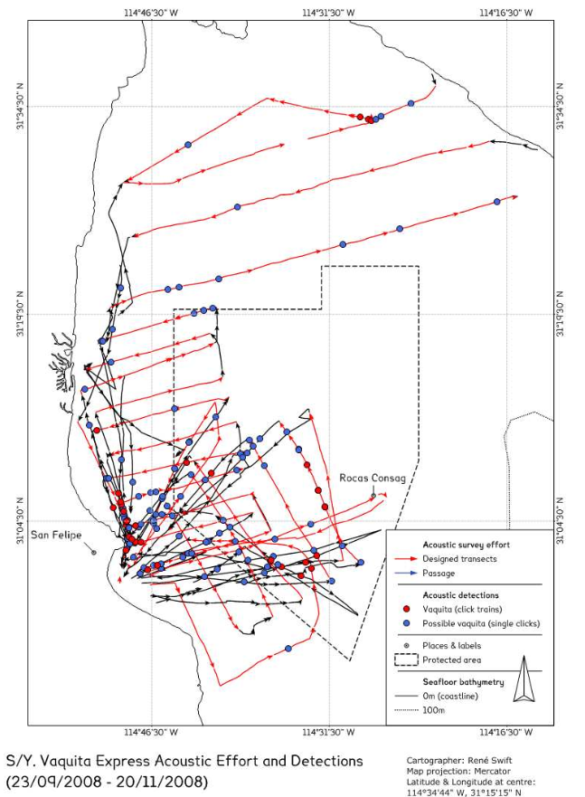
3. How a good static compromise fails:
Vaquita Monitoring Trials, 2008
probably false possibly true
The Vaquita makes NBHF clicks and these detections come from use of the standard PAMGUARD porpoise click detector on data from a hydrophone towed by a small sailing boat in a trial of methods carried out in the Upper Gulf of California.
‘Vaquita click trains’ here refers to groups of clicks without specific criteria on inter-click-intervals.
Detections to the left of the red line are extremely unlikely to be true as Vaquita have not been seen there for many years, while the main concentration of animals is within the core refuge marked by the dotted line. False positive here come mainly from dolphins and moving sand.
The false positives dominate the results making the method unusable, or if visual filtering is used, dependent on subjective evaluations that have never been adequately compared and tested, and did not work in this trial.
By contrast C-POD data showed a strong match to the distribution of sightings, because of their much lower false positive rate, and have given good data in this location ever since.
NOAA-TM-NMFS-SWFSC-459 Technical Memorandum
Armando Jaramillo-Legoretta, Gustavo Cardenas, Edwyna Nieto, Paloma Ladron de Guevara, Barbara Taylor, Jay Barlow, Tim Gerrodette, Annette Henry, Nick Tregenza, Rene Swift, Tomonari Akamatsu

Slide 9
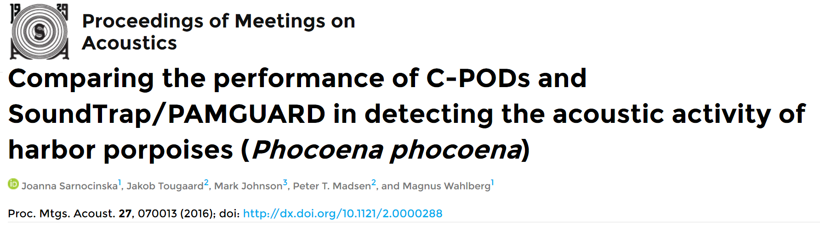
Comparing static and adaptive classifiers:
This paper shows big differences between classifier types.
The source data has not been made available, but some samples have been shared.
The next two slides show:
# an example of ‘good data’ that matches porpoise (NBHF) clicks well and show evidence of click train structure. These features match C-POD data.
# an example of data that better matches sediment transport noise with the lack of click train structure as seen in C-POD data.

Slide 10
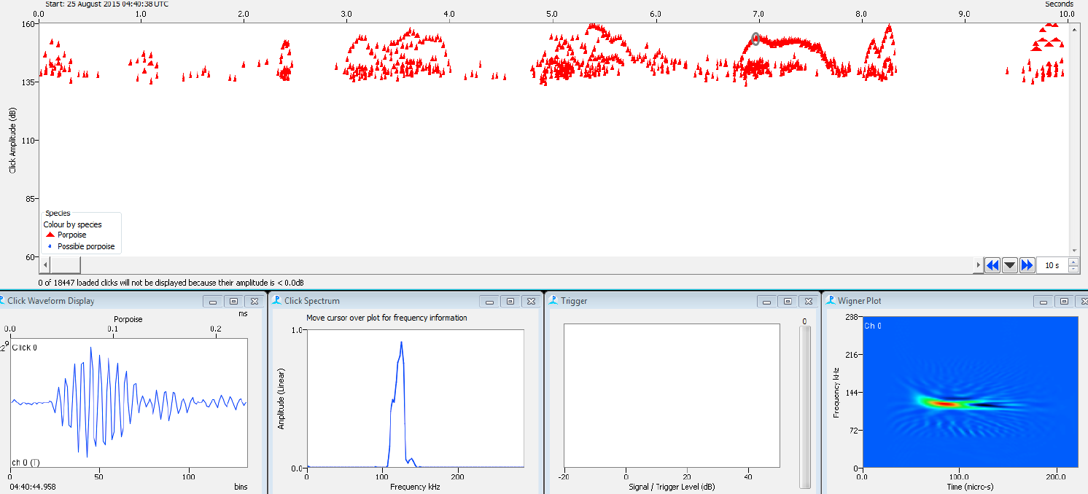
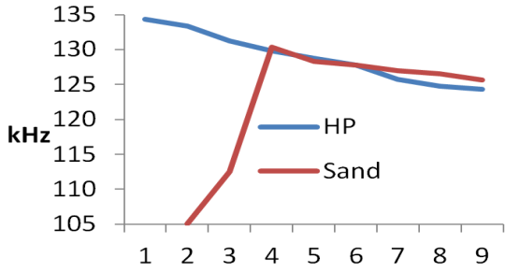
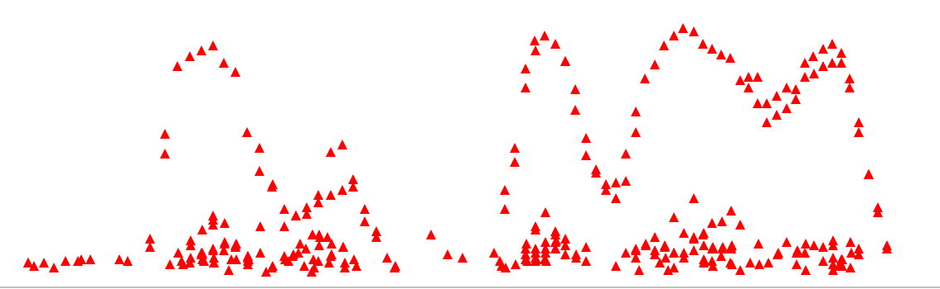
Comparing the performance of C-PODs and SoundTrap/PAMGUARD. POMA paper
SoundTrap / PAMGuard data - the good data:
The amplitude plot here shows typical click train amplitude envelopes going up to 160dB
with weaker multipath clicks seen below, giving a very typical structure..
The Wigner plot shows a slight frequency downsweep within the click and matches the typical C-POD-F finding:
Typical waveform with quiet background (seen before click)
All aspects of these PAMGuard detections closely match C-POD-F detections of porpoises as shown in this actual C-POD data from elsewhere, formatted similarly:
The C-POD-F captures successive wavelengths within some clicks. This graph shows the average of number of clicks from each source

Slide 11
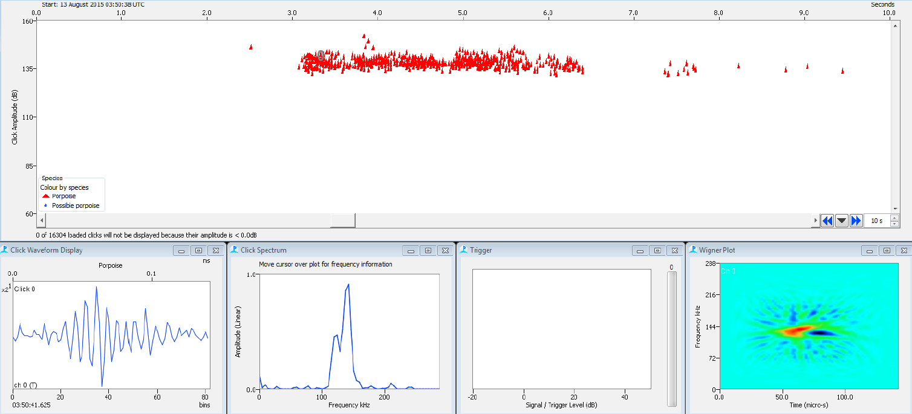
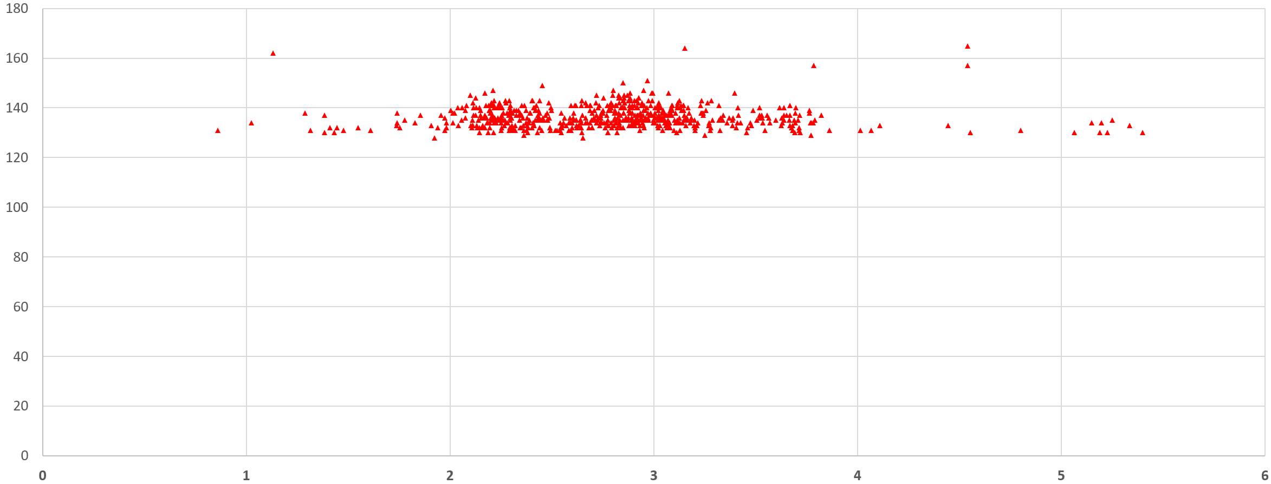
This data from the POMA paper is very different : the bad data:
This is a much-too-long weak train. Such long weak trains are very rarely captured from swimming animals. It shows: no very distinct amplitude envelopes, no clearly coherent sequences of inter-click-intervals, no distinctly weaker multipath clicks, and the click details are unlike porpoises:
The Wigner plot shows an initial rise (red) and then a slight fall (blue) as seen in C-POD-F data from sand noise. (see previous slide)
poor waveform: ragged amplitude profile. Background noise at ends looks rather similar.
The peak amplitude profile matches this actual C-POD data from sand noise. This is an example from elsewhere:
Conclusion: All aspects of these PAMGuard detections match C-POD-F detections of known sediment transport noise, but they have been classified in this paper as porpoise clicks.

Slide 12
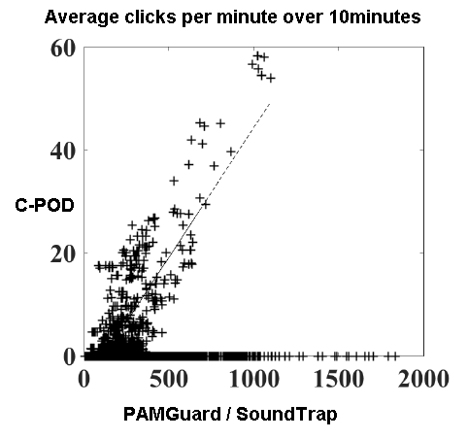
Comparing the performance of C-PODs and SoundTrap/PAMGUARD. POMA paper
The data set shows two distinct distributions:
1. Matching results - blue ellipse (porpoises)
2. Non-matching results - red rectangle
Did these non-matching clicks (2) come from porpoises?
No evidence is presented other than their similarity to porpoise clicks. However not one of many studies with C-PODs and actual sighting effort ever saw the highest levels of porpoise activity entirely missed by C-PODs, but this paper interprets the data several times in that way.
A more economical interpretation is that these very high counts from the PG/SoundTrap classifier are false positives.
This analysis of the data from the static classifier also shows that handling the false positive risk through human analysts can give very divergent results – as the case argued here does not match the result given in the paper.
However … ALL classifiers have problems!

Slide 13
4. Adaptive / Dependent classifiers
An alternative approach to try to get, at the same time:
  good sensitivity
  low false positive rate even in adverse conditions
is to have a classifier that adapts to the level of risk of false positives.
This performance advantage brings its own specific problems:
Multiple classifiers are needed to identify the sources of FPs as well as the target species. This classifier will be imperfect.
The sensitivity for the target species falls when a source of FPs is detected.
If the sources of FPs are commonly present and their prevalence is variable the sensitivity to the target will be correspondingly variable. Put the other way round: if you are monitoring a trend in one species and the prevalence of the sources of false positives stays more or less the same over the years they will not substantially impair the consistency of the data.
Studying interactions between the target species and any overlapping species (i.e. any source of FPs) will be affected by the bias, and this requires a different approach.

Slide 14
5. How do the KERNO-F classifiers work? … a technical diversion
The KERNO classifiers are adaptive classifier.
In each minute the classifier develops various indices for the prevalence of features of continuous noise sources (e.g. sediment transport noise), NBHF, other cetacean clicks, and sonars.
Within the minute each of these indices effectively creates a bias against classification of any of the train classes, except that continuous noise sources are not an identified class of train.
In a final feedback state the level of all these is assessed over a period that extends 5minutes before and after each minute, and the classification within the focal minute may be changed – unclassed trains may be given a class (upgraded) and trains that are not strongly typical of their class may be changed to unclassed (downgraded).
Sediment transport noise is a particularly difficult feature of the soundscape, as shown in the POMA paper, because it generates vast numbers of clicks that can be strongly tonal and have a wide range of envelopes.
For each train distance vectors are derived expressing where it sits on a line between each species class. These are vectors because, for example, being low frequency powerfully favours being an ‘other cetacean’ versus being an ‘NBHF’ species, but the converse is not true, so the distance requires a direction.

Slide 15
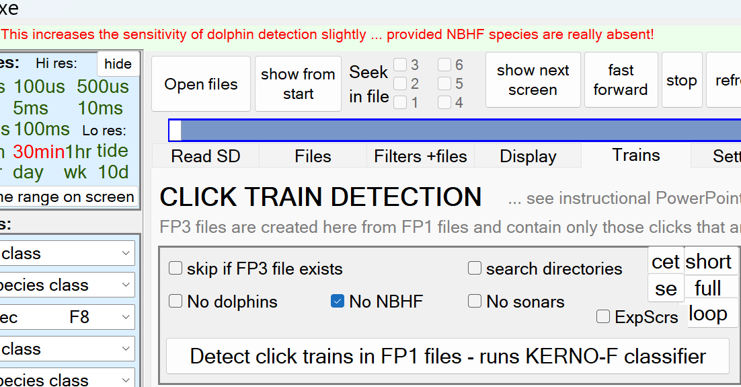
6. When does the interaction matter?
This paper, in JASA Express Letters,
  Dolphin and porpoise detections by the F-POD are not independent: Implications for sympatric species monitoring
  Mel Cosentino, Cristina Marcolin, Emily T. Griffiths, Estel Sánchez-Camí, Jakob Tougaard
identifies correctly the known interaction that occurs when dolphins and porpoises are present at the same place and time.
It then shows the effect of using the ‘No’ options shown >>>>>
These options inform the classifier that it does not have to worry about any one or two sources of false positives (dolphins, NBHF species, boat sonars) because they are absent from the file being analysed.
The app gives a warning at the top about when not to use these options. In this JASA Express letter those options are used and are treated as creating independent classifiers that can be ‘separated’.
Actually selecting ‘No NBHF’ will force all such click trains into the other cetacean class without applying the implicit constraints discussed in (2). ‘No sonars’ will force all porpoise-like sonars into the NBHF class.
The authors cite a file which has only one minute with dolphins. That rises to almost 700 minutes when the absence of porpoises is asserted, but validation of those detections would have shown that they were nearly all porpoise click trains that have now been wrongly forced into the dolphin category (giving results that would have been of great acoustic interest if porpoises had been absent!).
These ‘No options’ do not create an ‘independent classifier’ and should not be used in that way.
The well-known problem that the paper addresses does need to be understood, particularly in some situations:

Slide 16
6. When does the bias matter?
Continuous noise v. cetaceans
  In any long term study a trend in background noise will tend to create an opposite trend in cetacean detections. If the noise is low frequency the bias against high-frequency species will be less than against low-frequency species.
  This applies to all detection processes, and the ‘signal to noise ratio’, SNR, is often discussed and relevant.
  Sediment transport noise is always related to seastate, tides or wind speed, and both the noise and conditions have actual effects on cetacean activity.
Sonars (and pingers) v cetaceans
  The presence of boat sonars creates a bias against cetaceans because, when distant, their pulses can appear as tonal clicks in some train structure. Pingers make long tonal pulses that resemble sonar pulses, so they create bias, but they generally have no train structure, and suitable filtering can give bias free data.
  Sites with many sonars, like harbours and busy marine traffic areas can show substantial depression of cetacean detections, and – often forgotten – the sonars may repel the cetaceans as well. The time cost of manual revision of the data may be high, and the results subjective, so such sites should be avoided if possible for the study.
Dolphins v porpoises
  In most data sets the fraction* of minutes that may contain both classes is very low, so the impact on overall detection levels is trivial and can be ignored, but if you wish to study the real interaction of the species the bias is a major issue. It is asymmetric because NBHF clicks can be logged from dolphins the presence of dolphins creates significant bias against NBHF species. Because many dolphin clicks are never produced by porpoises there is minimal bias against at least that part of the dolphin click repertoire.
  The methods for studying interactions are discussed later.
The expected number of minutes with porpoises AND dolphins in a file can be calculated by assuming their distributions are completely independent. BothSpMins = NBHFmins * DolphinMins / AllMins The interaction in the classifier will reduce this.
The effect on overall detection rates, for dolphins, will be BothSpMins / DolphinMins but likely less as the interaction is unlikely to block all detections.
The effect of fishery pingers is more difficult to assess as there is no pinger class identified in KERNO-F

Slide 17
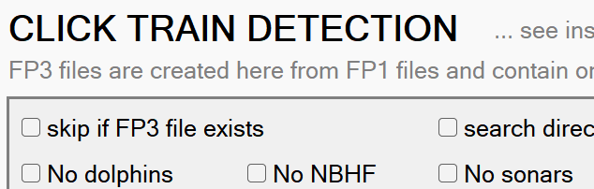
7. Solutions
Avoiding ‘irrelevant’ bias
Where it is known that there are no NBHF species,
or no sonars, or no dolphins (non-NBHF)
the classifier sensitivity can be increased
by giving it this information using these options:
Warning: if you select ‘No dolphins’ and ‘No sonars’ this will force all high frequency trains into NBHF i.e. it does not create a ‘good static classifier’ for NBHF, as described earlier, and should never be used for this purpose.
Visual Validation
An experienced analyst can perform better than the KERNO-F classifier by considering some significant features that it does not use e.g. the evolution, over time, of the encounter = the animals typically get louder as they approach and fade out quickly after they have passed the POD. To arrive at an accurate analysis will generally require looking at unclassed trains.
An account of the useful features is given in ‘Validation of the F-POD—A fully automated cetacean monitoring system’ Ivanchikova J. Tregenza N. https://doi.org/10.1371/journal.pone.0293402
Future Solutions
The KERNO-F classifier consists of a train identification process, followed by a species classifier that was developed using old-fashioned ‘feature engineering’ methods. Modern machine learning or AI methods should perform better and Chelonia is investigating them.
Another approach is to mathematically model the interactions and correct for them. This depends on having reasonably stable and accurate estimates of the interactions and has not been attempted in any study yet, and the only published quantitative estimate of any of the effects is in the paper above.

Slide 18
8. References and acknowledgments
Validation of the F-POD—A fully automated cetacean monitoring system Julia Ivanchikova, Nicholas Tregenza
  https://doi.org/10.1371/journal.pone.0293402
Passive acoustic monitoring of the decline of Mexico's critically endangered vaquita
  Armando Jaramillo-Legorreta, Gustavo Cardenas-Hinojosa, Edwyna Nieto-Garcia, Lorenzo Rojas-Bracho, Jay Ver Hoef, Jeffrey Moore, Nicholas Tregenza, Jay Barlow Conservation Biology 24 June 2016
  https://doi.org/10.1111/cobi.12789
Estimating cetacean population trends from static acoustic monitoring data using Paired Year Ratio Assessment (PYRA)
  Eric P. M. Grist, Trevelyan J. McKinley, Saptarshi Das, Tom Tregenza, Aileen Jeffries, Nicholas Tregenza. PLOS ONE March 17, 2022
  https://doi.org/10.1371/journal.pone.0264289
SAMBAH Estimating the abundance of the critically endangered Baltic Proper harbour porpoise (Phocoena phocoena) population using passive acoustic monitoring.
  Mats Amundin et al. Ecology and Evolution February 19 2022 https://doi.org/10.1002/ece3.8554
Dolphin and porpoise detections by the F-POD are not independent: Implications for sympatric species monitoring
  Mel Cosentino, Cristina Marcolin, Emily T. Griffiths, Estel Sánchez-Camí, Jakob Tougaard
  JASA Express Lett. March 11 2024
Thanks to Joanna Sarnocinska for access to data from her Master's Thesis used in the POMA paper discussed here.
Feedback is greatly appreciated: nick.tregenza@chelonia.co.uk

